Slide 1
Dynamic Epidemic Propagation in Community-Structured Networks
Arjun K. Nandan
Department of Humanities and Social Sciences Indian Institute of Technology, Roorkee
November 8, 2024
Arjun K. Nandan (Department of HumanitiesDynamic Epidemic Propagation in Communit
November 8, 2024
1 / 15

Slide 2
Introduction
Epidemic modeling has become a crucial tool for understanding and managing disease outbreaks.
In modern societies, community structures play a significant role in shaping disease transmission dynamics.
Network theory provides a powerful framework to capture these dynamics by modeling the underlying social interactions.
This study focuses on the use of Stochastic Block Models (SBM)
to simulate networks with distinct community configurations:
Sparse (minimal inter-community connections) Balanced (moderate inter-community connections) Dense (high inter-community connections)
Arjun K. Nandan (Department of HumanitiesDynamic Epidemic Propagation in Communit
November 8, 2024
2 / 15

Slide 3
Introduction
Epidemics spread faster in highly interconnected networks, potentially overwhelming healthcare systems.
Understanding how network topology influences epidemic progression can help design better containment strategies. The dynamic SIR model used in this study:
Captures real-world behavioral adaptations (e.g., social distancing). Incorporates an adaptive transmission rate based on the current epidemic state.
The goal is to provide quantitative insights into the relationship between network structures and epidemic dynamics, aiding policymakers in designing effective interventions.
Arjun K. Nandan (Department of HumanitiesDynamic Epidemic Propagation in Communit
November 8, 2024
3 / 15

Slide 4
Methodology: Network Structures
Stochastic Block Model (SBM):
Models networks with community structures by adjusting connection probabilities.
Captures real-world network diversity:
Sparse Networks: Low inter-community interaction. Balanced Networks: Moderate inter-community interaction. Dense Networks: High inter-community interaction.
Adjacency Matrix Representation:
0.1 p
p 0.1
P =
, p ∈ {0.001, 0.01, 0.05}
where p represents inter-community connection probabilities.
Arjun K. Nandan (Department of HumanitiesDynamic Epidemic Propagation in Communit
November 8, 2024

Slide 5
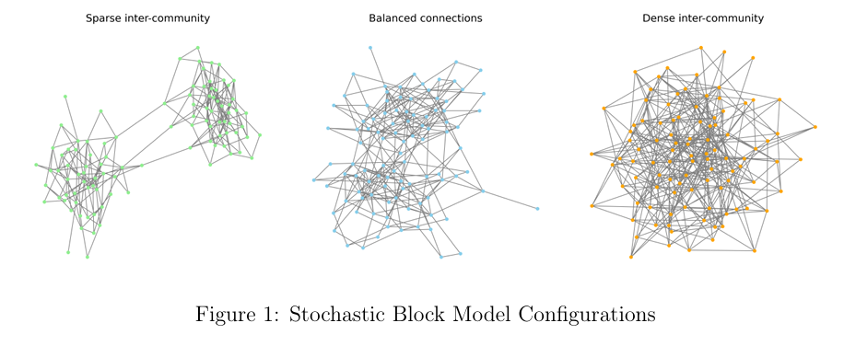
Methodology: Network Structures
Arjun K. Nandan (Department of HumanitiesDynamic Epidemic Propagation in Communit
November 8, 2024

Slide 6
Methodology: Epidemic Model
Dynamic SIR Model Equations:
dS
= −τ (t)SI
dt
= τ (t)SI − γI
dt
dI
dR dt
= γI
Dynamic Transmission Rate:
τ (t) = max(0.1 · τ₀, τ₀(1 − I_{f} )(1 − 0.5R_{f} ))
τ₀: Base transmission rate.
I_{f} (t) = ^{I (t)} : Fraction of infected individuals.
N
R_{f} (t) = ^{R(t)} : Fraction of recovered individuals.
N
Captures behavioral responses (social distancing) and herd immunity.
Arjun K. Nandan (Department of HumanitiesDynamic Epidemic Propagation in Communit
November 8, 2024

Slide 7
Results: Network Characteristics
Average Degree:
Measures the average number of connections per node.
Dense networks exhibit higher values, leading to faster epidemic spread.
Average Path Length:
Represents the average shortest path between nodes.
Dense networks have shorter paths, accelerating transmission.
Network Diameter:
Maximum shortest path between any two nodes.
Sparse networks show higher diameters, indicating isolated clusters.
Assortativity:
Indicates whether nodes prefer connecting with others of similar degree. Minimal impact on epidemic spread but reveals structural nuances.
Arjun K. Nandan (Department of HumanitiesDynamic Epidemic Propagation in Communit
November 8, 2024

Slide 8
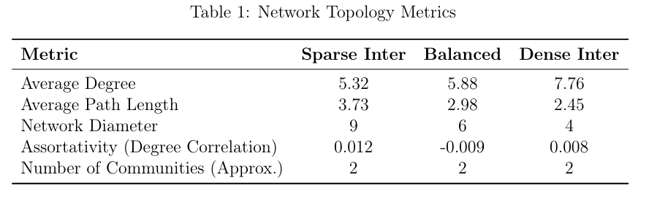
Results: Network Characteristics
Arjun K. Nandan (Department of HumanitiesDynamic Epidemic Propagation in Communit
November 8, 2024

Slide 9
Results: Epidemic Dynamics
Peak Infection Rate:
Dense networks exhibit the highest peak due to increased connectivity. Sparse networks limit the spread, delaying and lowering the peak.
Time to Peak:
Dense networks reach the peak faster, reducing time for interventions. Sparse networks provide longer windows for containment measures.
Outbreak Size:
Final outbreak size remains stable across network types, suggesting similar long-term impacts.
Arjun K. Nandan (Department of HumanitiesDynamic Epidemic Propagation in Communit
November 8, 2024

Slide 10
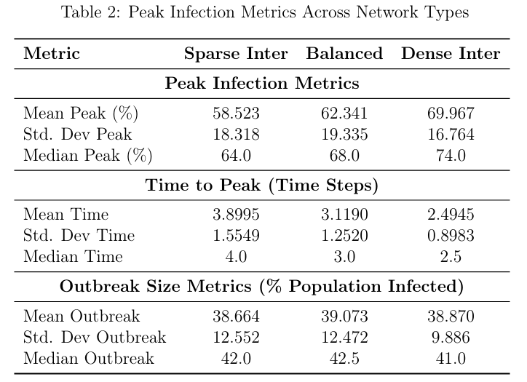
Results: Epidemic Dynamics
Arjun K. Nandan (Department of HumanitiesDynamic Epidemic Propagation in Communit
November 8, 2024

Slide 11
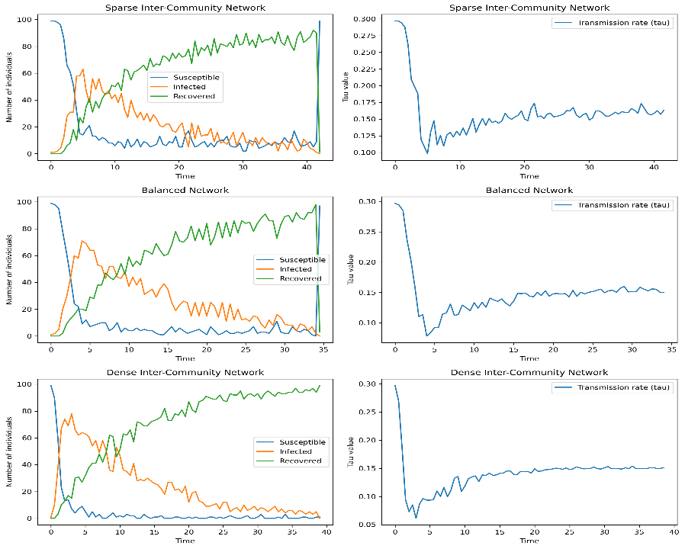
Epidemic Dynamics
Arjun K. Nandan (Department of HumanitiesDynamic Epidemic Propagation in Communit
November 8, 2024

Slide 12
Conclusion
Network structure significantly influences the dynamics of epidemic spread.
Dense networks lead to faster, more intense outbreaks.
Sparse networks delay the spread, offering critical containment opportunities.
These insights can guide public health strategies, optimizing intervention timing and targeting.
Arjun K. Nandan (Department of HumanitiesDynamic Epidemic Propagation in Communit
November 8, 2024

Slide 13
References
1
Keeling, M. J., & Eames, K. T. (2005). Networks and epidemic models. *Journal of the Royal Society Interface, 2*(4), 295–307.
Ma, J., & Wang, P. (2024). Impact of community networks with higher-order interaction on epidemic dynamics. *Chaos, Solitons Fractals, 180*, 114471.
Pastor-Satorras, R., Castellano, C., Van Mieghem, P., & Vespignani,
A. (2015). Epidemic processes in complex networks. *Reviews of Modern Physics, 87*(3), 925–979.
K Rizi, A. (2024). Spreading and epidemic interventions-effects of network structure and dynamics.
Barth´elemy, M., Barrat, A., Pastor-Satorras, R., & Vespignani, A. (2005). Dynamical patterns of epidemic outbreaks in complex heterogeneous networks. *Journal of Theoretical Biology, 235*(2), 275–288.
2
3
4
5
Arjun K. Nandan (Department of HumanitiesDynamic Epidemic Propagation in Communit
November 8, 2024

Slide 14
References
Par´e, P. E., Beck, C. L., & Ba¸sar, T. (2020). Modeling, estimation, and analysis of epidemics over networks: An overview. *Annual Reviews in Control, 50*, 345–360.
Sottile, S., Kahramano˘gulları, O., & Sensi, M. (2024). How network properties and epidemic parameters influence stochastic SIR dynamics on scale-free random networks. *Journal of Simulation, 18*(2), 206–219.
6
7
Arjun K. Nandan (Department of HumanitiesDynamic Epidemic Propagation in Communit
November 8, 2024

Slide 15
Thank You
Arjun K. Nandan (Department of HumanitiesDynamic Epidemic Propagation in Communit
November 8, 2024

